Slide 1
The value of Cloud to 92G
By Ajwad, Jared and Harsh

Slide 2
92G SCENARIO
Video-game developer that wants to digitize their recruitment process
Process and manage applicant data and communication

Slide 3
On premises
Applications
Data
Must manage everything
Expensive to train and manage
Focus taken away from solution for irrelevant tasks
Runtime
Middleware
O/S
Virtualization
Servers
Storage
Network

Slide 4
What is Cloud Computing?
“Cloud computing is the delivery of computing services—including servers, storage, databases, networking, software, analytics, and intelligence—over the Internet (“the cloud”).”

Slide 5
Cloud Service models
IAAS
PAAS
SAAS
Infrastructure as a Service
Platform as a Service
Software as a Service
Developers
Developers
End Users

Slide 6
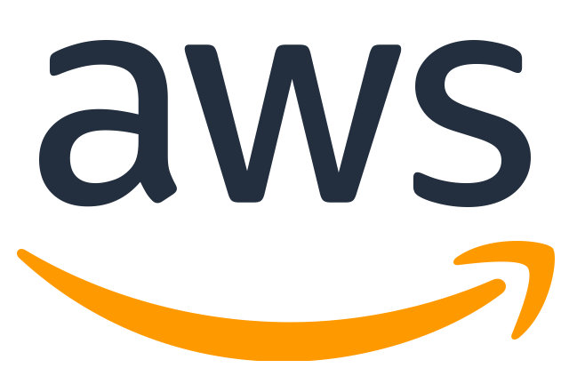
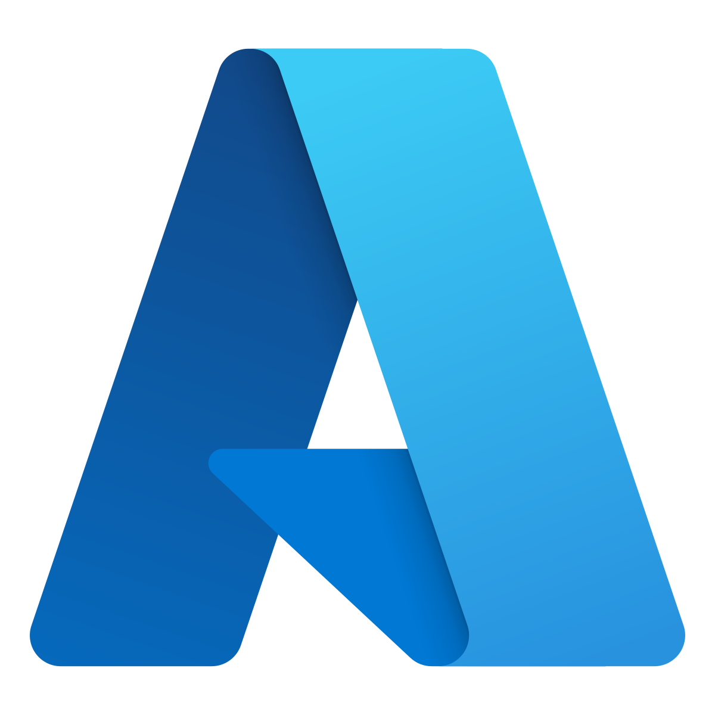
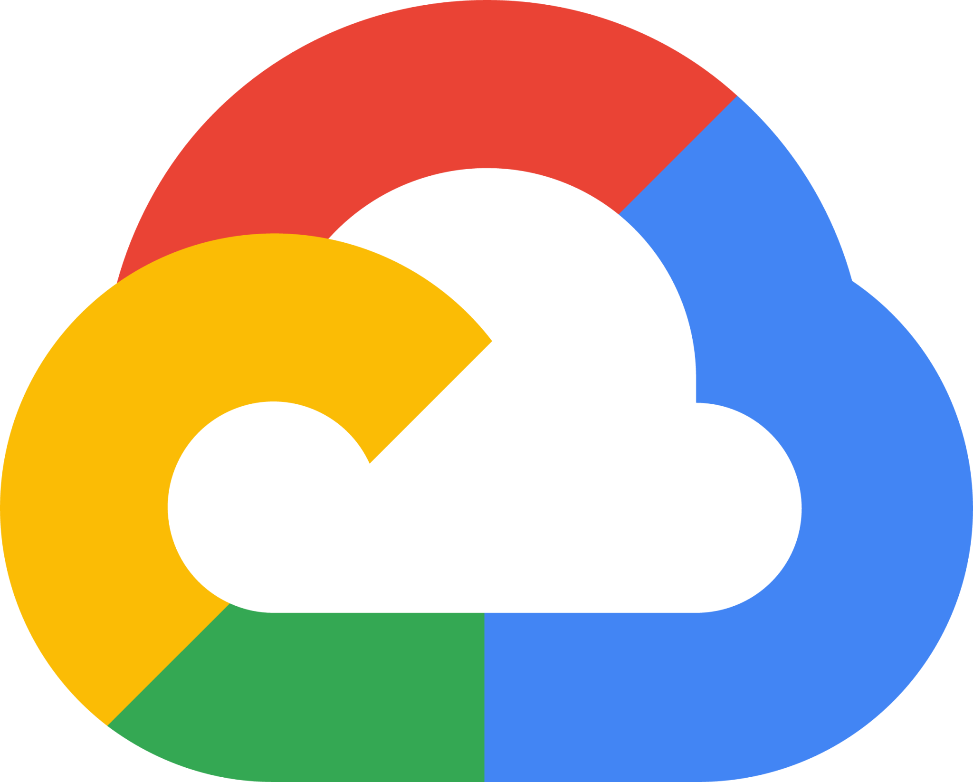

INFRASTRUCTURE AS A SERVICE
Applications
Data
Allows developers to develop without having to worry about underlying infrastructure
Runtime
Middleware
O/S
Virtualization
Servers
Storage
Network

Slide 7

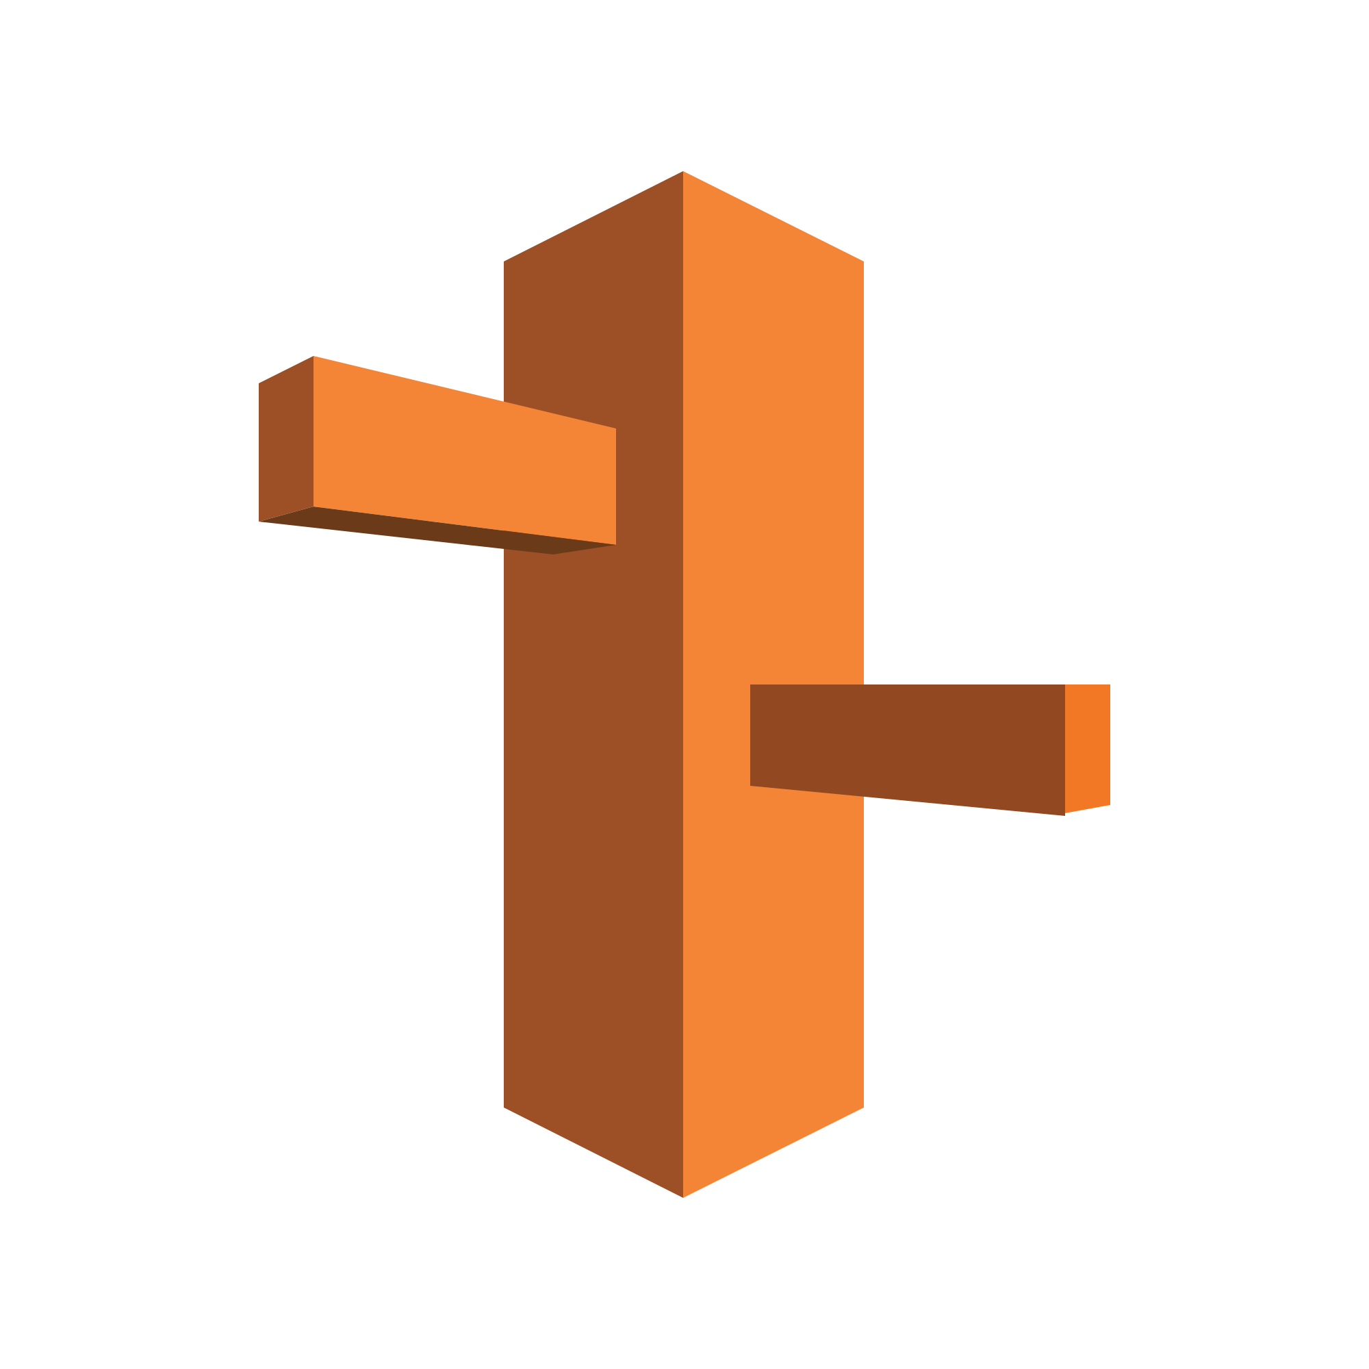
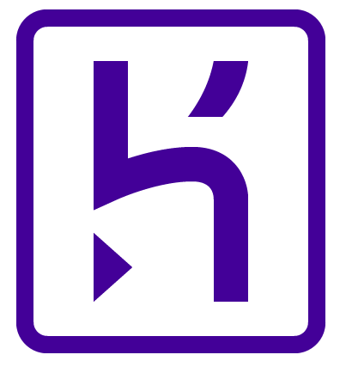
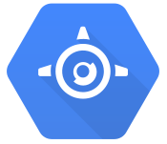
Platform AS A SERVICE
Applications
Data
Allows developers to develop without worrying about underlying infrastructure as well as software setup.
Runtime
Middleware
O/S
Virtualization
Servers
Storage
Network

Slide 8

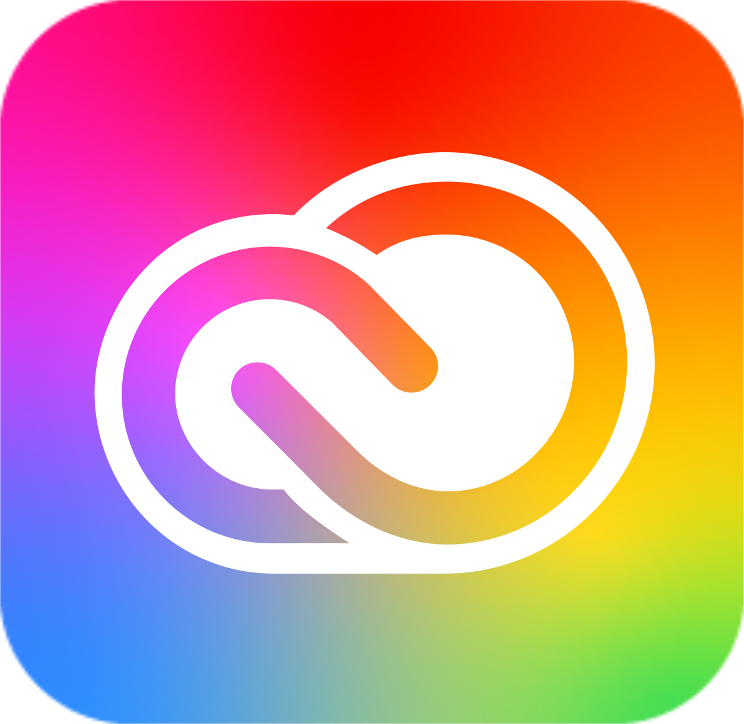

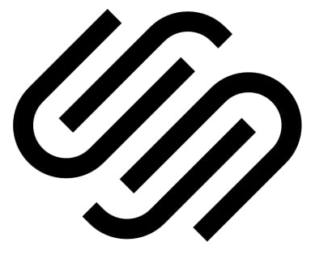
Software AS A SERVICE
Applications
Data
Everything is handled by the CSP, resulting in applications usable out of the box. Targeted at end-users.
Runtime
Middleware
O/S
Virtualization
Servers
Storage
Network

Slide 9
Cloud DEPLOYMENT MODELS
PUBLIC
PRIVATE
HYBRID
COMMUNITY

Slide 10
Cloud SDLC
Plan
Design
Implement
Test
Deploy
Maintain
Notes:
Provides structure for the development process
Efficient communication between technical teams and non-technical teams
Time management
Translates the client’s vision into a reality

Slide 11
Waterfall
agile
Plan
Design
Implement
Test
Deploy
Maintain
Plan
Design
Implement
Test
Deploy
Maintain
Notes:
Waterfall
Sequential (output of task is input for the next)
All requirements must be planned in advance
Rigid (can’t go back), can’t react to changes in vision
Outdated
Agile
Iterative
Flexible
Modern (Widely used)

Slide 12

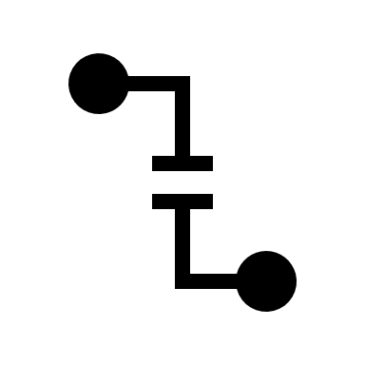
Why is Security important
Sensitive data compromised
Processes
disrupted
Notes:
Mention data compromise consequences: legal and safety issues.
Causes of data compromise can be malicious insiders/Unathorised Access
Causes of process disruptions would be system misconfigurations/DoS attacks
Speak how these can badly affect 92 G accordingly

Slide 13
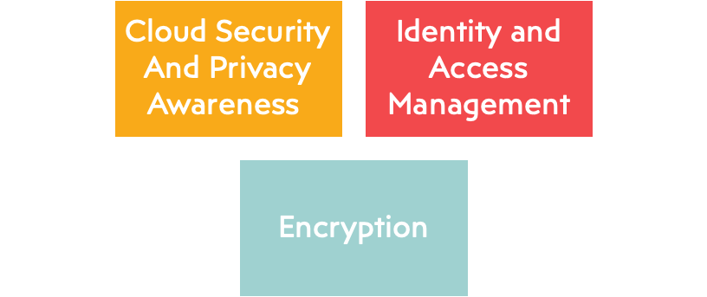
Cloud Security Solutions
Notes:
Cloud Security and Privacy Awareness helps employees and management understand authorized access and prevention of account miss use or theft and how to combat it
IAM and how it can prevent malicious insiders and help add a layer of security through authorized access(practice notes from unused slides)
Encryption ads security to prevent data compromise and add a extra layer of security

Slide 14




Benefits
Global scale
Cost
Separation of concerns
Security & Reliability
Notes:
Global Scale – CSP’s have servers around the globe. Allows us to reach applicants more effectively. 92g would have to implement global servers to get same reach.
Cost – Setting up and managing all the infrastructure and software cost a lot of money. Cloud services charge a small fee in comparison. 92g would save a lot of money.
Separation of concerns – Like Ajwad mentioned earlier. Cloud offers various levels of abstraction allowing 92g to focus resources on their solution and let the CSP handle irrelevant but necessary tasks.
Security and reliability – CSPs are experts that are able to operate are large global scale so they are far more reliable than on premises. Furthermore they have implemented Security measures from experience that 92g doesn’t have yet.

Slide 15


limitations
Internet access requirement
Vendor lock-in
Hidden costs
Legal requirements
Notes:
None of them are dealbreakers

Slide 16
Cloud solution for 92g
PAAS model
Public deployment
Agile SDLC
IAM & teaching awareness
Notes:
PAAS – IAAS doesn’t abstract software setup. SAAS abstracts everything and so doesn’t provide enough control. PAAS allows for development of applicants and management of data without software/hardware setup.
Public – No legal issues and no existing infrastructure to migrate so no need for private and hybrid.
IAM -

Slide 17
Any questions?
Also, thanks for listening ☺

